Slide 1
Lecture 7 System architecture Input-output
Computing platforms, semester 2
Novosibirsk State University University of Hertfordshire
D. Irtegov, A.Shafarenko
2019

Slide 2
CdM-8 as a chip
Unmarked outputs on the top: register monitors
IRQ, vector and IAck we will discuss later
In and out buses are memory bus

Slide 3
CdM-8 in von Neumann (Manchester) setup

Slide 4
CdM-8 in Harvard setup

Slide 5
I/O as a memory cell
Sequential logical device is
a set of registers
some combinatory logic
If we make some registers available to CPU, we can
Read [parts of] state of the device
It is up to device designers to make this part of the state usable
Change state of the device (issue commands and transfer data)

Slide 6
I/O device: [part of] keyboard and a display

Slide 7
Reading data from the keyboard
Uppermost (7th) bit of data latch is reset to 0 on key press
And to 1 on data read
Thus, CPU can poll (repeatedly read) the data until bit 7 is 0
While polling, CPU cannot do anything else
Also, polling leads to high CPU load and power consumption
If CPU does something else (timed polling), it cannot react to keyboard immediately
In multithreaded programming, polling is considered harmful
But on low level I/O you sometimes have no other choice

Slide 8
Code sample

Slide 9
Interrupts (alternative to polling)
Interrupts are hardware service that allows
I/O devices to signal events
CPU to handle (process) them
Require changes to CPU internal architecture
CPU must poll IRQ signal on every fetch cycle
If the signal is present, instead of fetching next instruction CPU starts interrupt handling sequence
To handle interrupt, CPU saves parts of its state (PC and PS registers) and calls a handler (interrupt service routine, ISR)

Slide 10
Changes to CdM-8 CPU
Interrupt Master (IM) , which senses interrupt requests, decides if the interrupt must be granted and fetches the interrupt vector from the device
Interruptable Sequencer latching Virtual Interrupt Instruction (VII) instead of a normal Fetch based on the PC.
Extension of the Secondary Decoder to accommodate the execution of the VII,
Extension of the Instruction Set with the rti instruction (return from interrupt): the last instruction that an ISR must execute.
Interrupt Arbiter handles the situation when several devices request interrupts at overlapping periods

Slide 11
Why handle interrupts only on Fetch stage?
If we handle interrupts only between ISA instructions, we can save registers needed for ISR programmatically (and not save ones not needed)
If we handle interrupts inside of the instructions, we must save all state of the CPU, including registers which are not available programmatically (IR, RR, RX, sequencer state)
In industrially used CPU, that would break compatibility between CPUs with same ISA but different RTL architecture (e.q. AMD and Intel)

Slide 12
Peripherals
IM
vector
int
IRQ
…
vec-adr
Interrupt Arbiter
Interrupt Arbiter
IAck
IRQ
v₁
IAck
IRQ
v₂
IAck
device i/f
device i/f
hold
fetch
int enabled
DP triggers
phase1
Sequencer
…
Secondary Decoder
int
…
latch
phase5
fetch
op-code
fetch logic
Primary Decoder
taken
branch logic
CVZN
PS
PC=PC+1
read
latch
shared with DP
instr
cond
PC
Memory
instr
IR
addr
DP selectors
shared with DP
int

Slide 13
Interrupts from software point of view
Every interrupt-capable device has unique number on range 0 to 7
Every possible value of device numbers selects a byte pair, called interrupt vector
By default, interrupt vectors are mapped to upper 16 bytes of memory
In Manchester architecture, these are same bytes as used for memory mapped I/O, so you cannot use all 7 interrupts and all 16 register addresses
In Harvard architecture, I/O is mapped to data memory, and vectors to program memory

Slide 14
But what happens when interrupt occurs?
Device sets IRQ request on CPU input line
When CPU finishes every instruction, it polls IRQ request line
If interrupts are enabled (we will discuss this later), it retrieves device number
Then, instead of instruction at mem[PC], VII (ioi) instruction is executed
In some sence, ioi is “normal” instruction: it has an opcode, it can be inserted in a machine code and executed like any other command
This is called “software interrupt”
But during interrupt, no ioi instruction is present at mem[PC]
But CPU behaves like it fetched this instruction

Slide 15
Ioi instruction
Phase 1 decrement SP for stack push
Phase 2 store PC on stack; decrement SP for stack push
Phase 3 store PS on stack
Phase 4 fetch new PC value from vector’s first cell (0xf0 + 2R)
Phase 5 fetch new PS value from vector’s second cell (0xf1 + 2R)
It is similar to jsr, but two registers are saved (PC and PS)
You need to use rti instruction to return from ioi routine
And call target depends on hardware (device number R)
So you can write specific handler routine for every device

Slide 16
What you can do in interrupt handler?
Typically, interrupt signals that device has some data for you
So you must retrieve the data
Some devices require further instructions, what to do next
For example, when you read data from the disk, you must tell the disk what sector to read or write next (or not tell anything and disk will be idle)
Then you must set some flags so main program will know the data are ready
Then you must return to main program (execute an rti instruction)
Or you can do something else (we will discuss it in Operating Systems course)

Slide 17
Why interrupts are bad?
They are asynchronous
They can occur in any moment of program execution
It is very easy to write a handler that can break a main program (damage its data)
And it is very hard to catch this condition by testing
So, there is a mechanism to disable interrupts (a flag in PS register)
Interrupt handling is a simplest (and historically first) form of parallel programming, and parallel programming has many pitfalls
And most of these pitfalls are hard to avoid
There will be courses on concurrency and parallel programming further in our curriculum

Slide 18
Why interrupts are good?
You can handle several event sources at same time
You do not need to rewrite your program to add another event source
You can do something useful when waiting for an event
Operating systems use interrupts to implement multithreading and multitasking

Slide 19
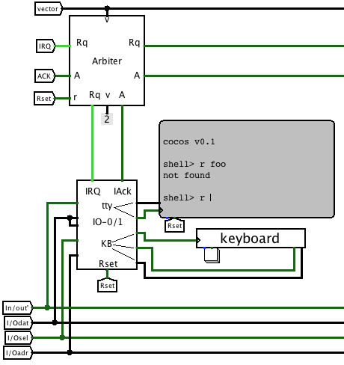
Terminal device
Has a full ASCII keyboard
and ASCII display
I/O port is shared: in is kbd, out is screen
Kbd sends interrupt when key is pressed

Slide 20
Terminal device driver
ISR reads the char from keyboard
And inserts it into a ring buffer
Main program can read the data
from the buffer, when it is not busy with other tasks
Output data are put to the screen immediately
Code is in the tome.pdf

